Slide 1
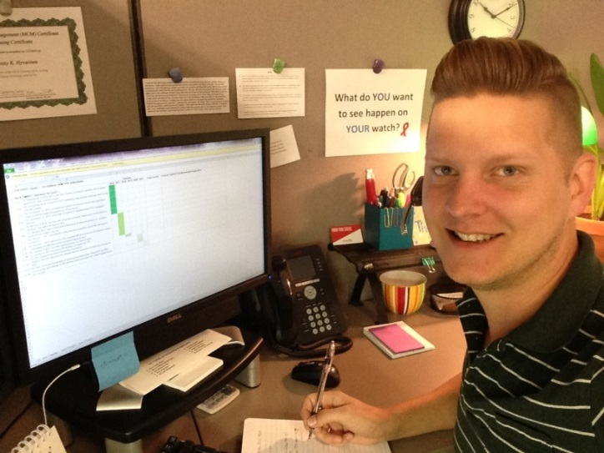
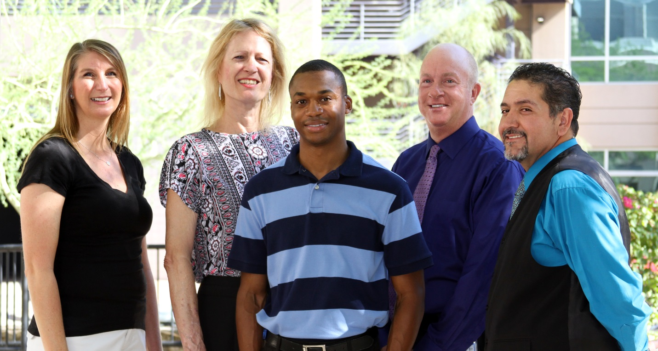
Developing New Leaders to End HIV: A Leadership Academy Model
Randall Furrow, MBA and Jeremy Hyvarinen
Ryan White HIV/AIDS Program Part A Planning Council, Phoenix EMA – Phoenix, AZ, United States  Maricopa County Ryan White HIV/AIDS Program Part A, Phoenix, AZ, United States
Introduction
Methods
Results
Conclusions
The Ryan White HIV/AIDS Program (RWHAP) Part A Planning Council, the RWHAP Part D Consumer Advisory Board (CAB), and the Arizona Statewide HIV Advisory Group (SWAG) identified a need for enhanced leadership development among their members to fully engage stakeholders in statewide planning processes. A Leadership Academy was designed to provide the knowledge, skills and abilities necessary to develop additional community leaders capable of completing the essential functions of developing a statewide plan to end HIV in Arizona.
The goals and objectives agreed upon by the participants of this specific academy were utilized to lay the ground work for the development of the strategies and activities for the Statewide Integrated Plan. These goals, objectives, and strategies will be implemented as part of the efforts to effectively end the HIV epidemic in Arizona by 2021.
Insert Webinar Photo Here
34 community members/stakeholders completed the Leadership Academy and participated in developing the draft goals, objectives and strategies.
Participant evaluations of the Leadership Academy were overwhelmingly positive, ranging from 94%-99% satisfaction, citing high quality content.
Participants identified that the activities were relevant, the opportunities presented translated into real life situations, and the applied operational plan development exercises provided the skills needed to help the planning bodies meet their goals of fully engaging in the planning process.
Participants provided positive feedback on the opportunity to develop relationships which will strengthen the state’s efforts to implement the developed plans.
The goals and objectives developed by the Leadership Academy participants were provided to strategic planning groups and served as the foundation for the work which was completed during sessions at the 2nd Annual Statewide HIV Symposium.
68% of Leadership Academy participants attended the Symposium.
66% of newly appointment consumers on the Planning Council attended the academy.
59% of participants of are members of the RWPA Planning Council, RWPD CAB, and/or the Statewide Advisory Group (SWAG).
97% of participants have contributed to the completion of Arizona’s Statewide Integrated Plan.
Over 300 community members/stakeholders have participated in the statewide integrated planning process.
The new mandate to develop a Statewide HIV Integrated Plan presented several challenges to the programs that provide HIV services across Arizona. Planning processes across agencies often experience delays due to differences in terminology, procedures, and outcome expectations.
At the beginning of the planning process, the Ryan White and HIV Prevention Leadership Teams committed to ensuring the HIV services provided to the community would be designed with input from community leaders, and reflect the medical, social support, and cultural needs of the community. The RWHAP Part A Planning Council, CAB, and SWAG committed to providing the highest level of guidance and direction to the Ryan White and HIV Prevention Programs in this planning process. These planning bodies identified a need for additional leadership development to assist their members in achieving their mission.
The evaluations and feedback from the participants in this Leadership Academy, along with the increased participation in the integrated planning process by the community leaders demonstrates that the planning bodies received the support they needed to improve their leadership skills. Achievement of this goal will continue to enhance the contributions of the planning bodies in the HIV Community as the Arizona Ryan White and HIV Prevention Services programs work toward the overall goal of effectively ending the HIV epidemic in Arizona by 2021.
Leadership Academy Format
Two Full Day Didactic Sessions covering topics such as Transitioning into Leadership, Expectations of Leaders, Preparing and Conducting Effective Meetings, Building Effective Relationships and Partnerships were led by experts in the fields of leadership training and strategic planning.
Group Activities conducted to develop strategic planning skills, and draft preliminary goals, objectives and strategies designed to effectively end the HIV epidemic in Arizona.
Homework Assignments related to drafting objectives and strategies of agreed upon overarching goals.
Two Interactive Webinars were utilized to further develop the recommended goals, objectives and strategies before being submitted to the Statewide Integrated Planning Leadership Team.
A strategic planning session during Arizona’s 2nd Annual Statewide HIV Symposium was utilized to adapt the recommendations for four separate regions across Arizona.
Thank You!
Thank you to the following agencies, community partners and other stakeholders for their participation in this successful effort: Area Agency on Aging (Care Directions), Arizona AIDS Education and Training Center at University of Arizona College of Medicine, Chicanos Por La Causa, Coconino County Public Health Services District, Ebony House, Inc., Maricopa Integrated Health Systems/Ryan White Part C and D Programs, National Community Health Partners, Native Health of Phoenix, Terros Health, and the Arizona Department of Health Services Ryan White Part B and HIV Prevention Programs.
A special THANK YOU to our academy facilitators at Knowledge Capital Alliance, Inc.
ANY QUESTIONS REGARDING THIS POSTER, PLEASE CONTACT:
Jeremy Hyvarinen, Care Continuum Coordinator
RWHAP Part A, Maricopa County
P: 602.506.6181  Email: hyvarinenj@mail.maricopa.gov
Order online at https://www.postersession.com/order/

